Slide 1
AI Powered Hospital Information Management System
Project Code: HIMS-AI-2526
Internal Advisor: Mr. Aamir Zia
Project Manager: Dr. Muhammad Ilyas
Project Team:
Ali Akbar BSCS51F22R036 (TL)
Muhammad Najee Ullah Noon BSCS51F22S043

Slide 2
Project Overview
Modern hospitals often struggle with inefficiencies caused by manual data entry, fragmented record-keeping, and time-consuming administrative processes. These challenges lead to delays in patient care, errors in documentation and increased workload on medical staff. To address these issues, the AI-Powered Hospital Information Management System (HIMS) is proposed as an intelligent, automated platform that integrates speech recognition and natural language processing to streamline hospital workflows. The system functions as follows:
1. AI-Based Conversation Recording and Analysis: The system listens to doctor–patient interactions in real time, identifies the speaker, and extracts key medical information such as symptoms, diagnosis, prescribed treatments, and follow-up details.

Slide 3
Project Overview
2. Doctor Confirmation and Data Storage: Before saving, the extracted data is displayed to the doctor for verification. Once confirmed, it is automatically stored in a centralized hospital database.
3. Dedicated Dashboards: Uses dedicated separate dashboards for doctor, patient, receptionist, and admin.

Slide 4
Project Overview
Doctor Dashboard: Enables doctors to view patient histories, review notes, and manage consultations.
Admin Dashboard: Allows hospital administrators to manage records, monitor data flow, and ensure system compliance.
Patient Portal: Provides patients with access to their medical history, prescriptions, and reports.
Reception Dashboard : Manages incoming patients’ accounts and appointments.

Slide 5
Project Scope
The scope of the AI-powered Hospital Information Management System (HIMS) is defined by its focus on improving patient record management, reducing administrative workload, and supporting accurate medical documentation through AI assistance, while keeping doctors in control of validation. The project is specifically designed for healthcare institutions and has clear boundaries on what it will and will not cover.
Inclusions:
AI-Assisted Medical Note Creation: The system captures doctor-patient conversations, highlights relevant medical details (symptoms, diagnoses, tests), and presents them for doctor confirmation before storing in the database.

Slide 6
Project Scope
Centralized Patient Record Management: Hospitals can maintain structured medical histories, accessible to authorized staff across visits.
Integrated Staff Dashboard: Enables staff to verify or edit patient records, and oversee hospital operations such as scheduling and reporting.
Secure Patient Access: Patients can receive their reports digitally through their profile or via staff-provided printed documents.
Data Analytics for Hospitals: Aggregated data helps identify trends in patient issues, treatment effectiveness, and administrative workload.

Slide 7
Project Scope
Exclusions:
Full Clinical Decision-Making: The system does not recommend treatments or prescribe medicines; it only records and structures doctor-validated information.
Cross-Hospital Data Sharing: Patient data will not automatically transfer between hospitals unless formally integrated with external systems.
Self-Registration by Patients: Initial patient accounts will be created by hospital staff; self service registration will not be included in the current scope.
Non-Medical Hospital Operations: The system will not handle unrelated tasks such as payroll, pharmacy stock management, or facility maintenance.

Slide 8
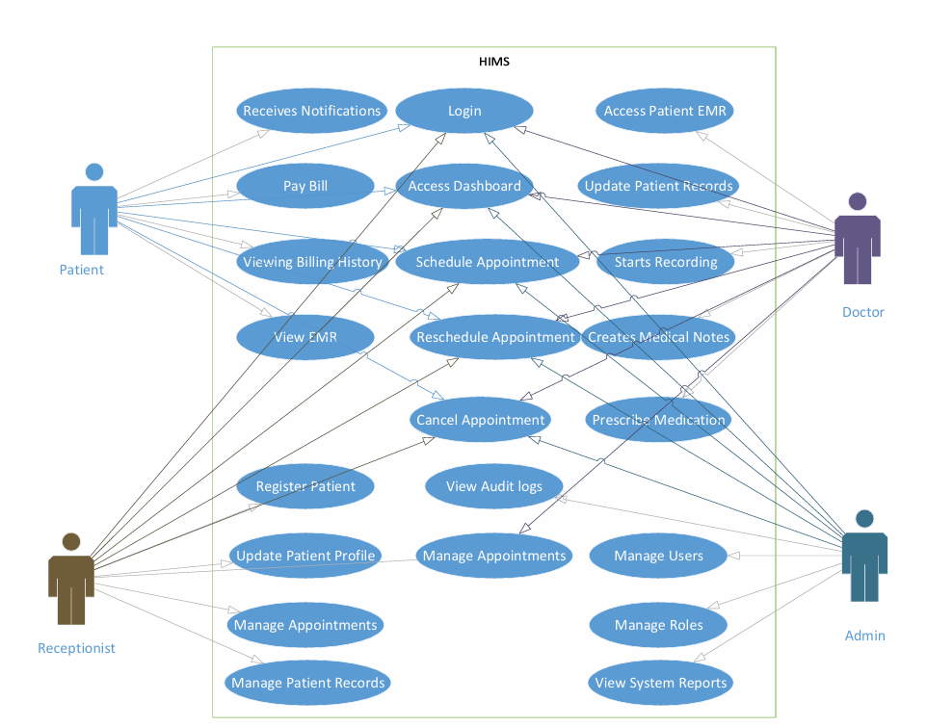
Use Case Diagram

Slide 9
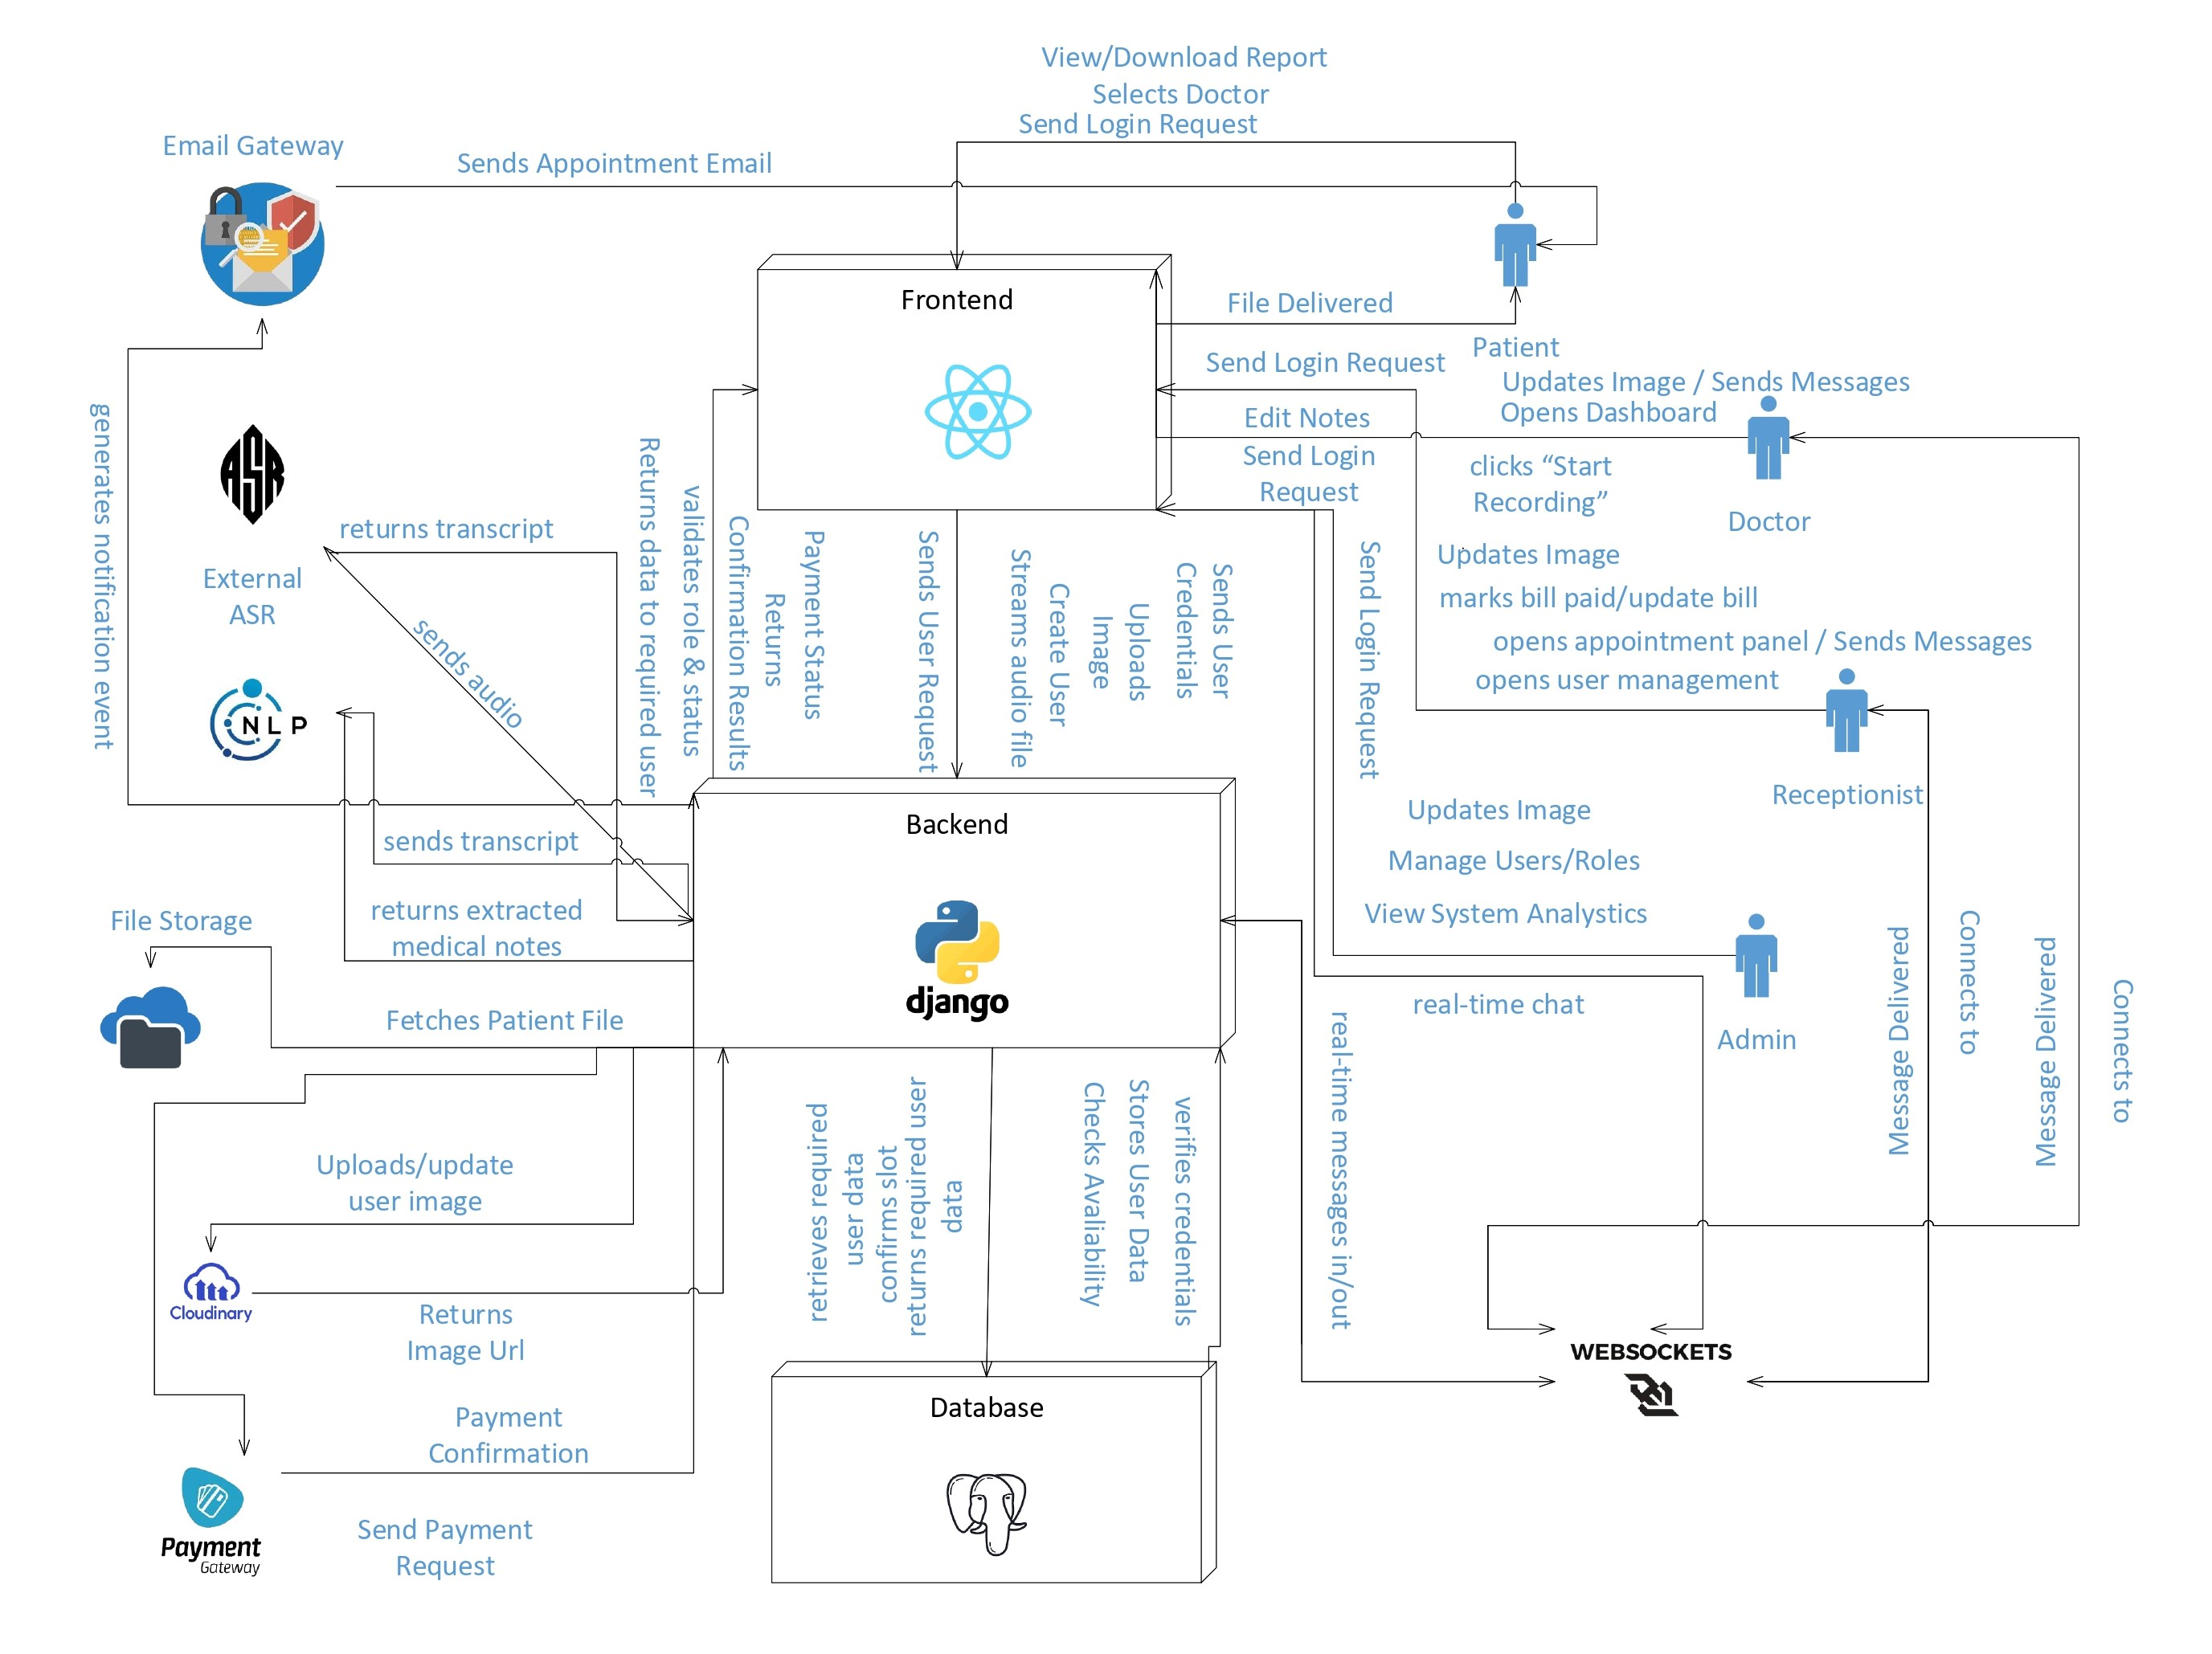
Architecture Diagram

Slide 10
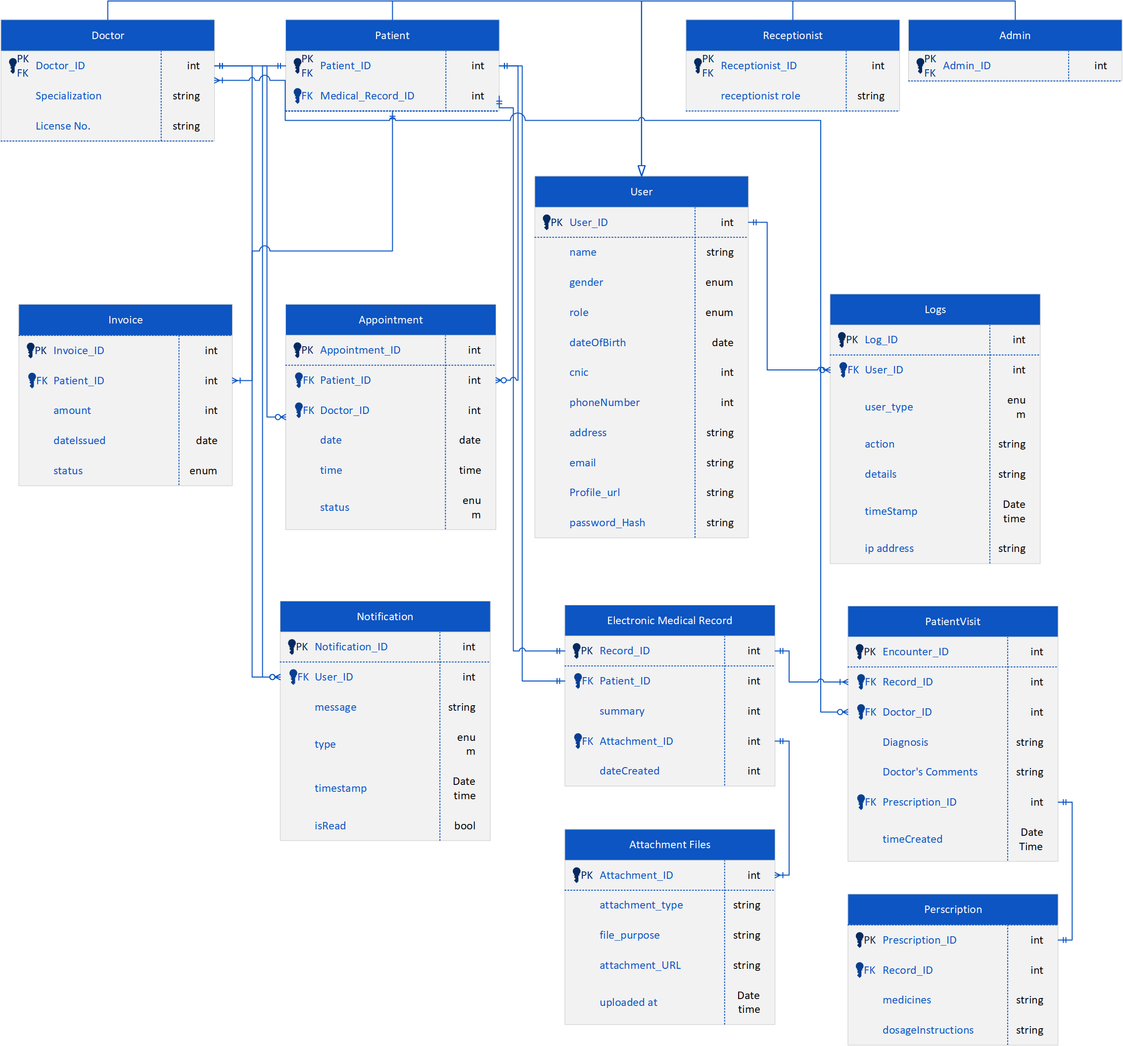
ER Diagram

Slide 11
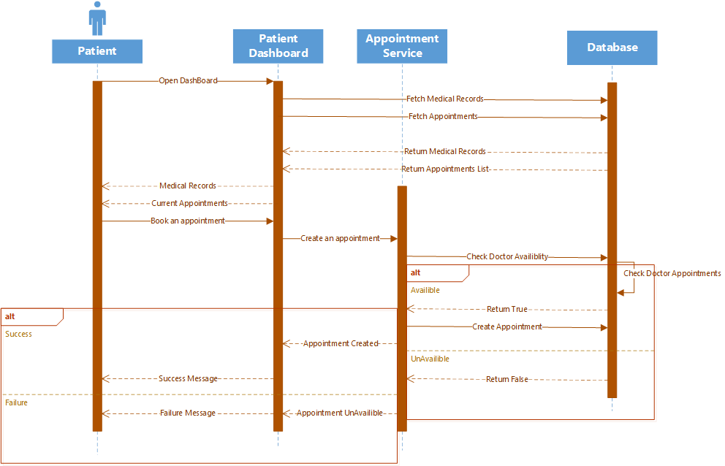
Sequence Diagram (Patient)

Slide 12
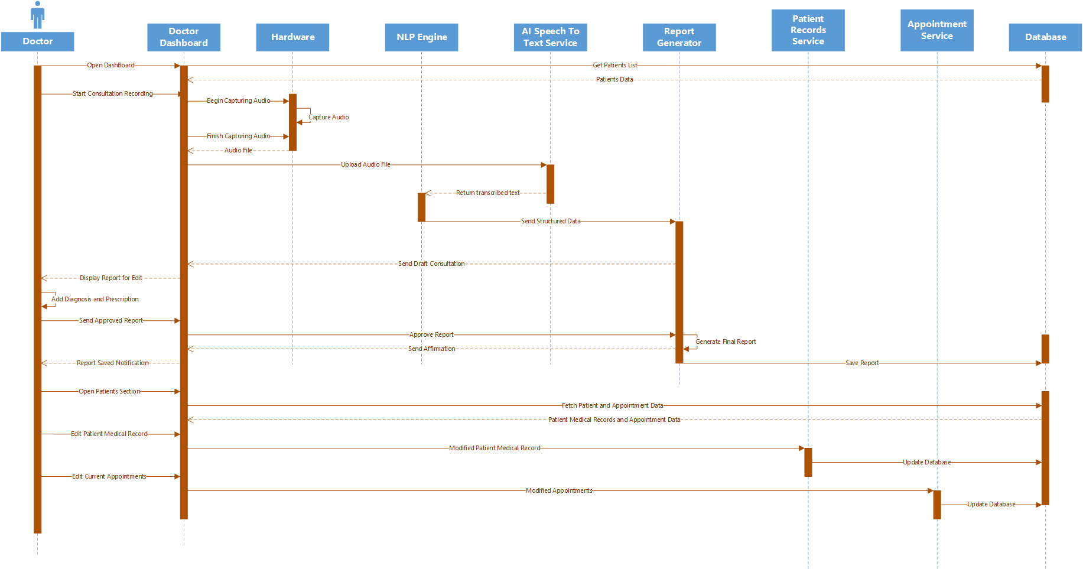
Sequence Diagram (Doctor)

Slide 13
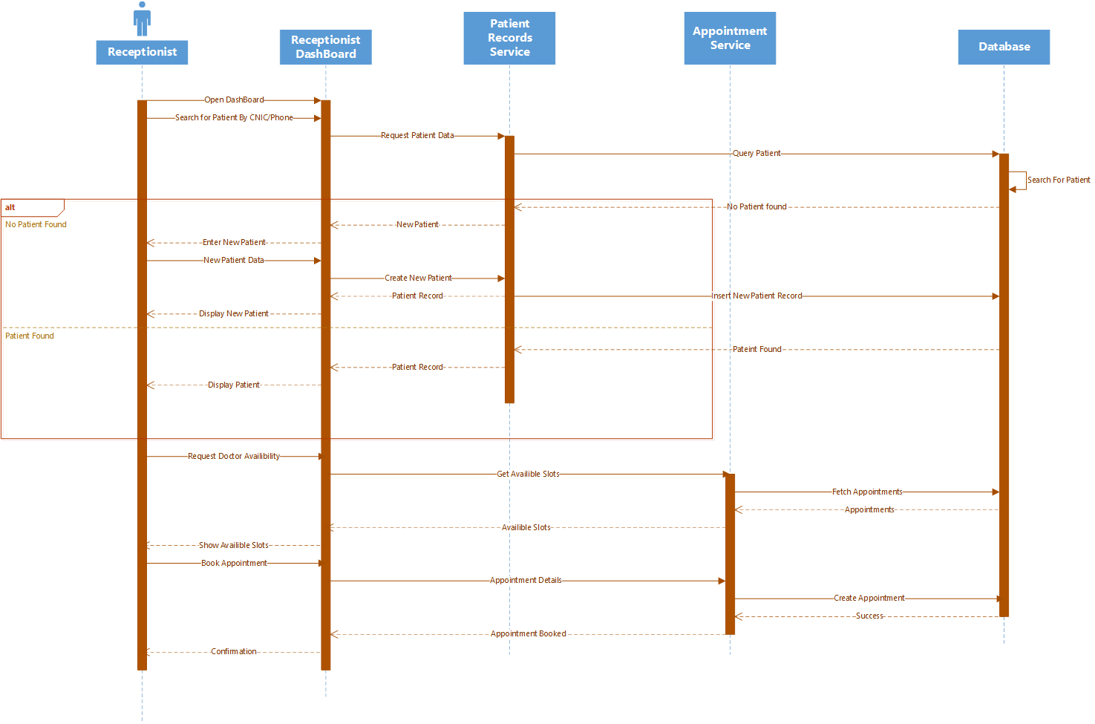
Sequence Diagram (Receptionist)

Slide 14
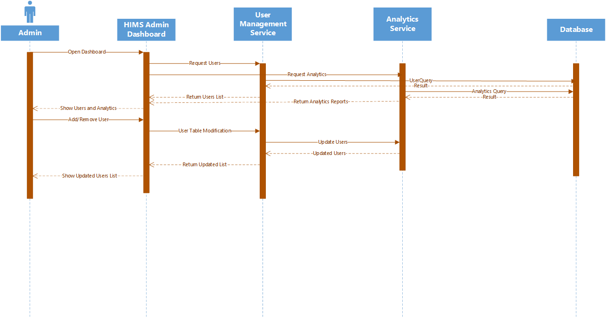
Sequence Diagram (Admin)

Slide 15
Thanks

